Slide 1
Cloud IoT
Get started with Cloud IoT Platforms

Slide 2
IoT Cloud Offering
IBM Watson
ThingSpeak - Demo
MS Azure IoT hub
Adafruit - Demo
AWS IoT Core
Google IoT Core

Slide 11
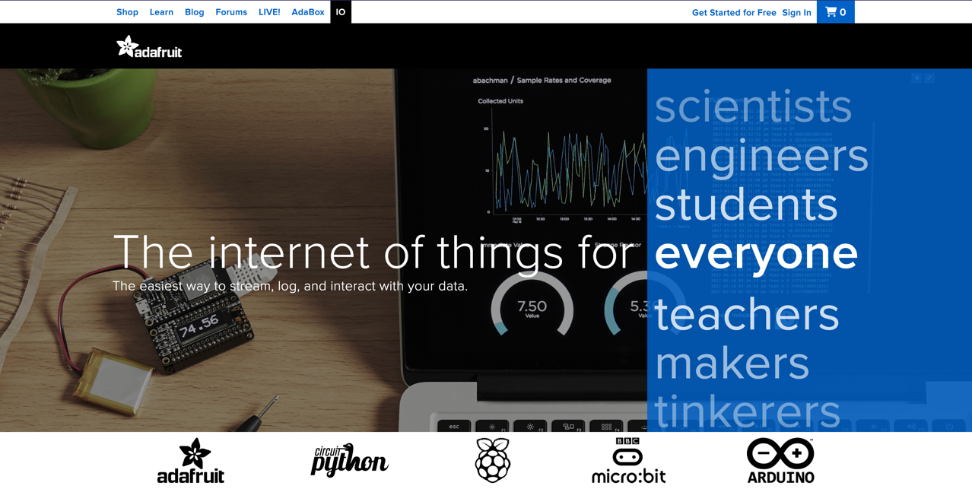

Slide 12
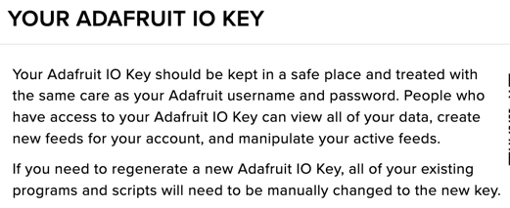
Adafruit – Open source hardware & Software
Dashboard
Feed – Like Topic, one can subscribe/publish to this.
Adafruit Cloud act as a Broker
Use AIO key to connect to your Adafruit Cloud broker.
Client program uses Feed created on dashboard to subscribe and can take some local action.

Slide 13
SaMplE Code
Download Sample Adafruit python Program below
https://github.com/sdntechforum/Fun-with-IoT/blob/0000307b0cd259cea38b7297be9d6f7d9366acec/adafruit_mqtt.py

Slide 14
Demo
Notes:
Consider talking about:
Antimov
AVC

